Slide 1



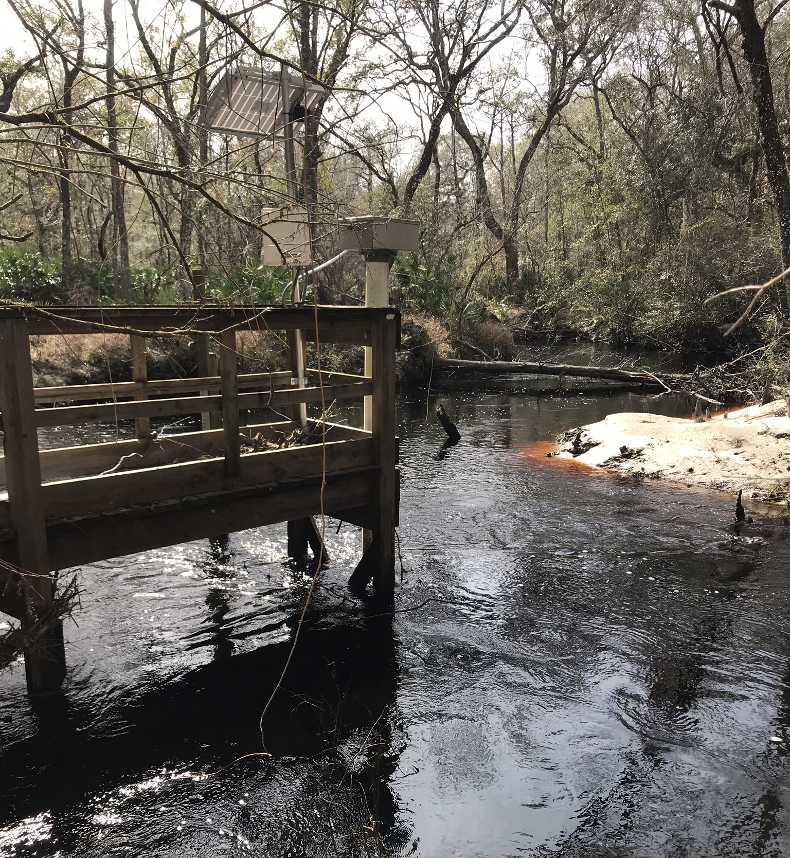
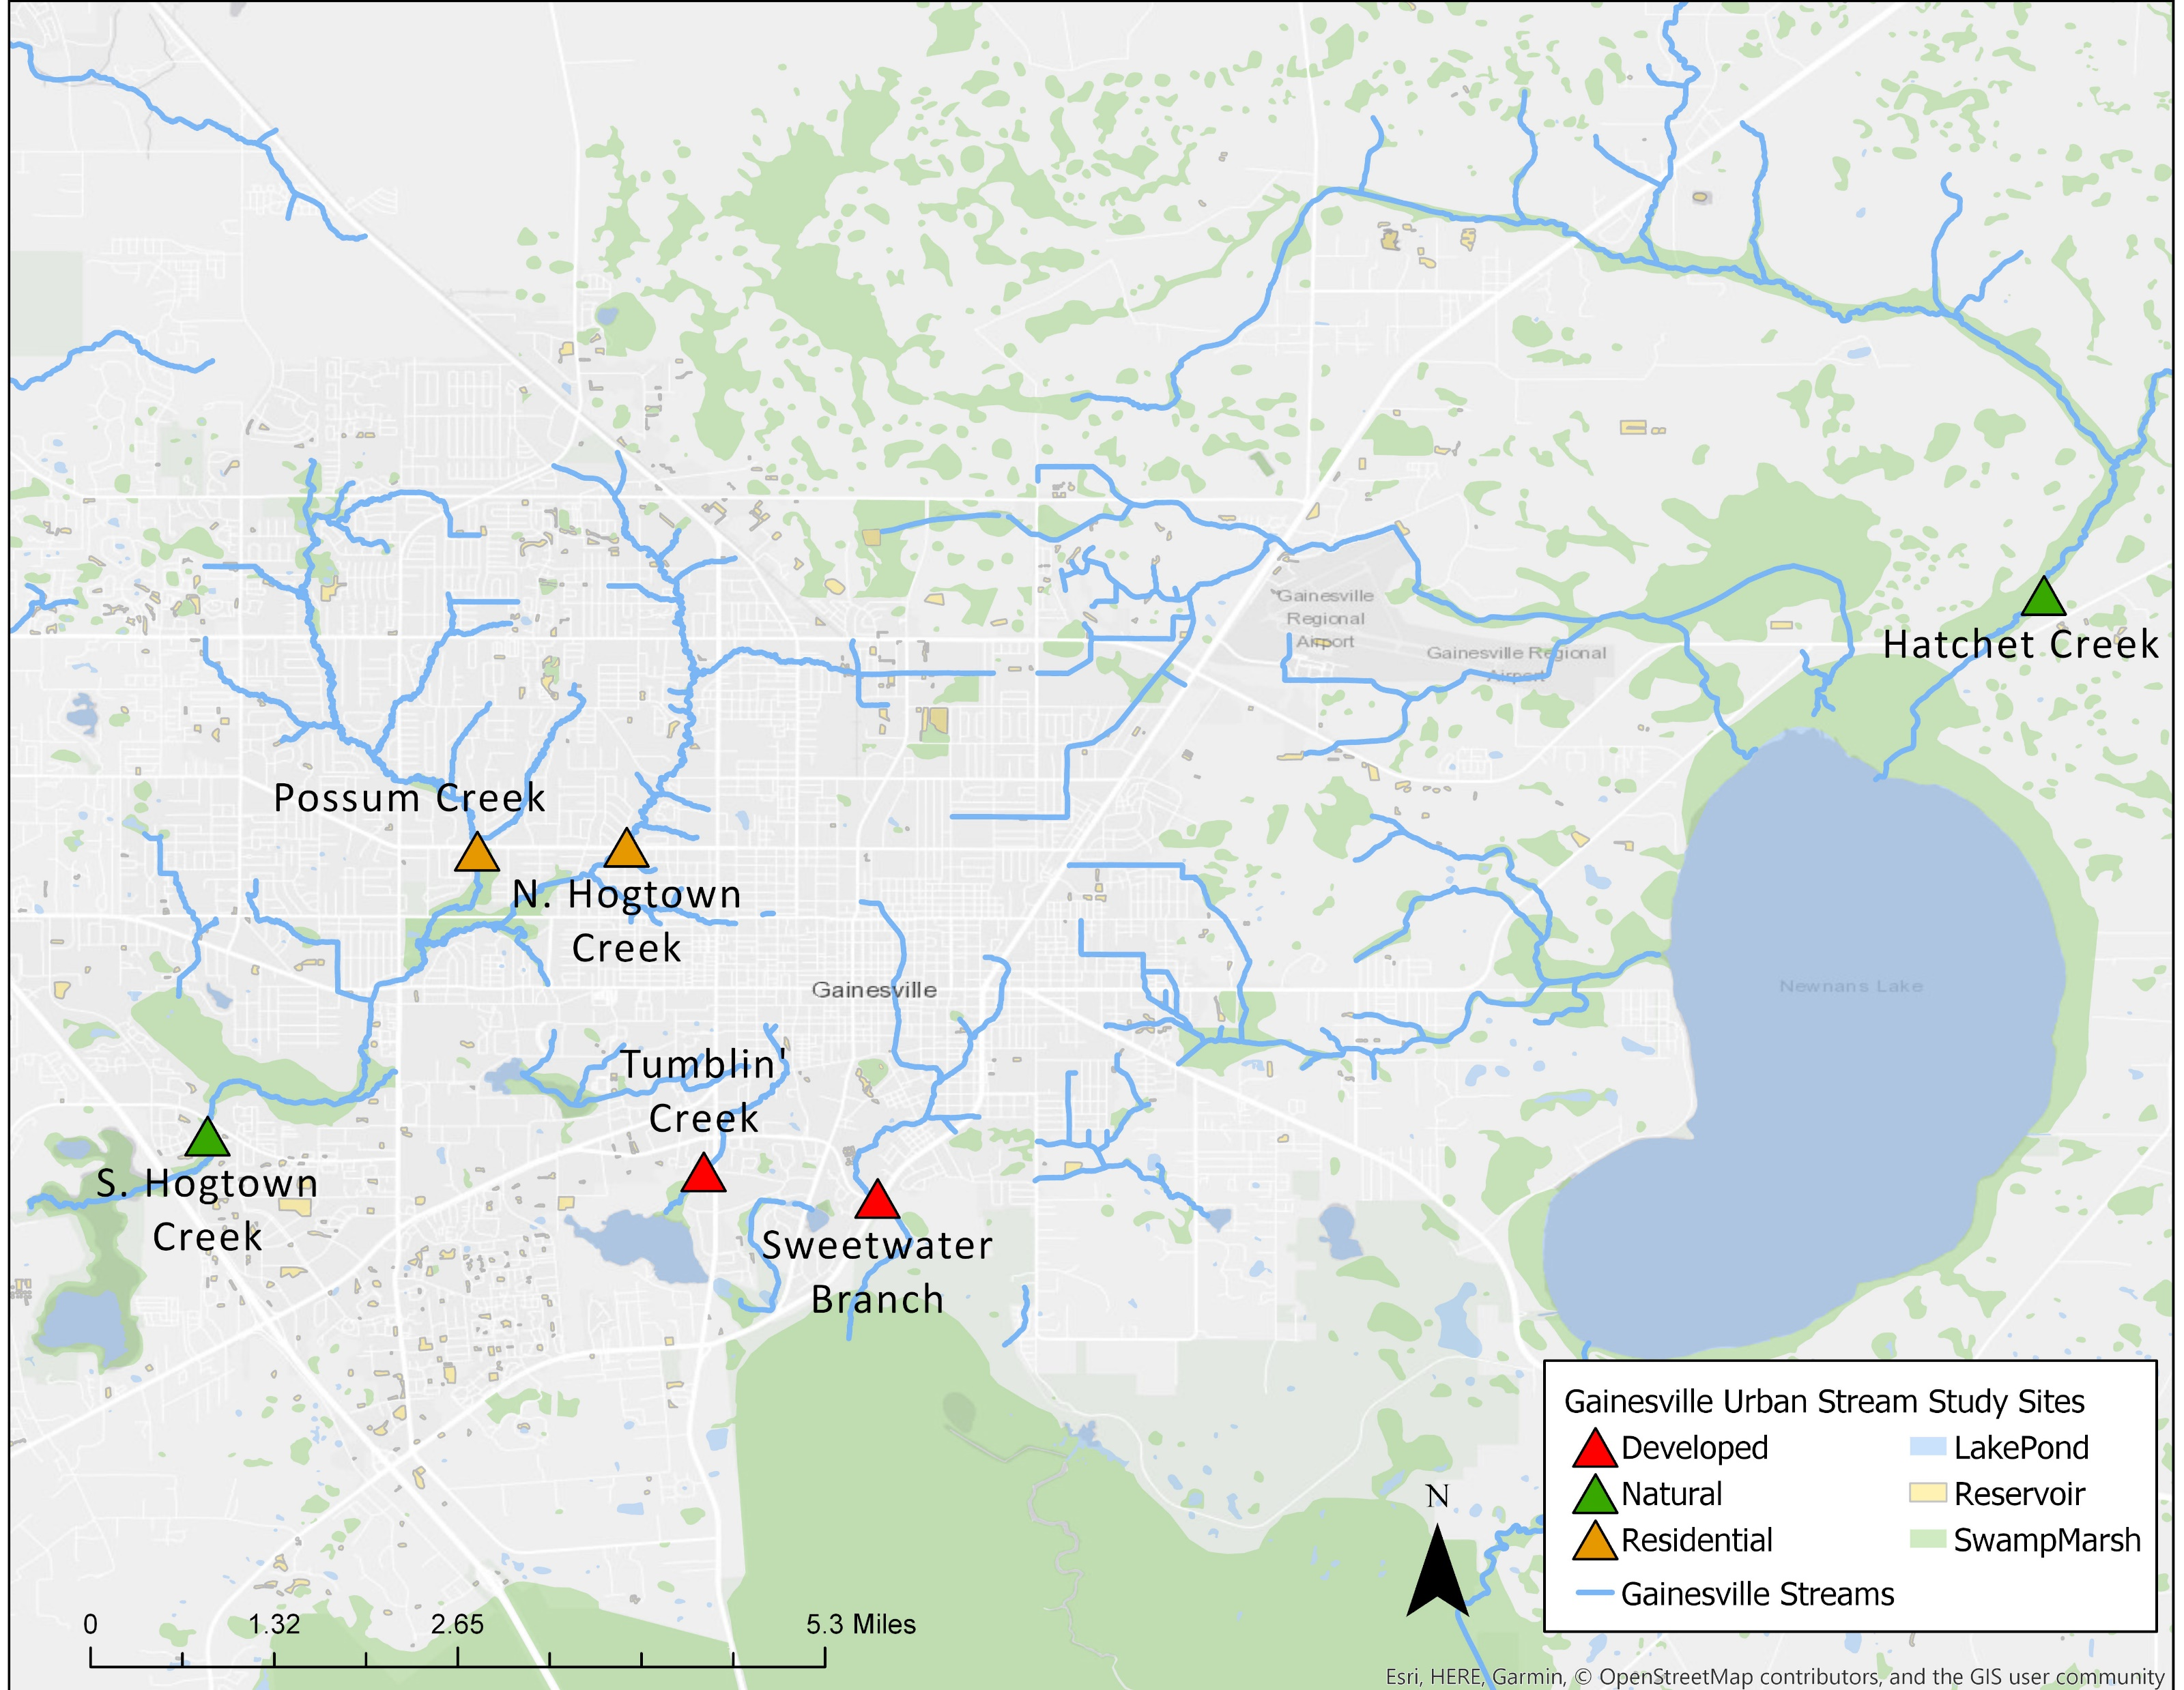
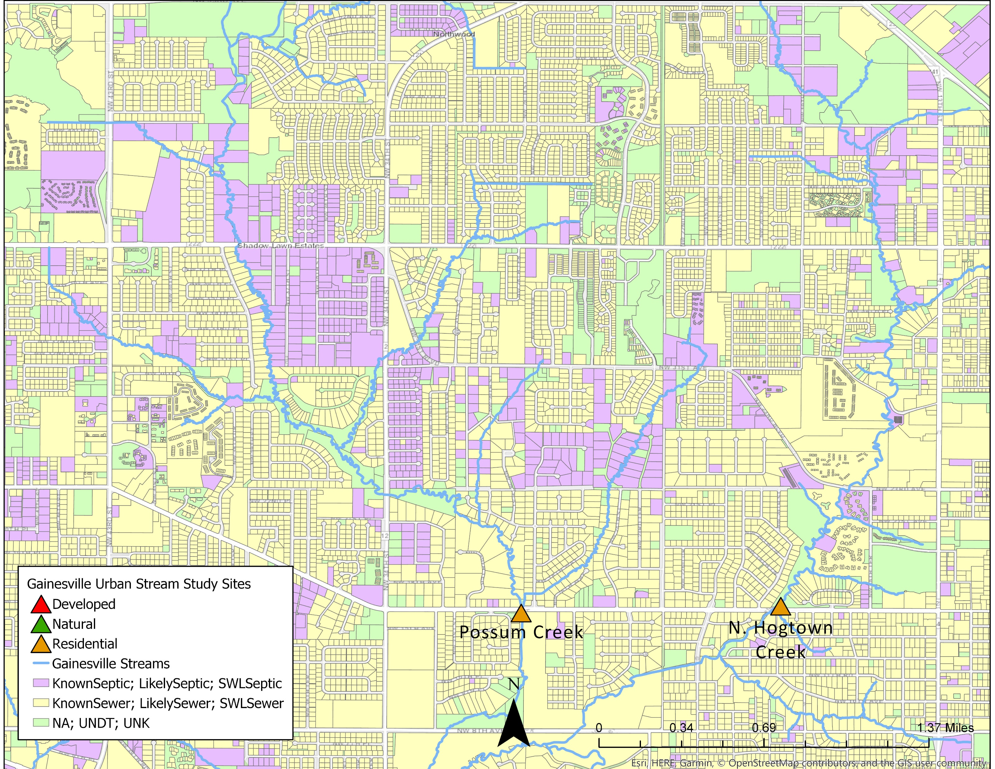
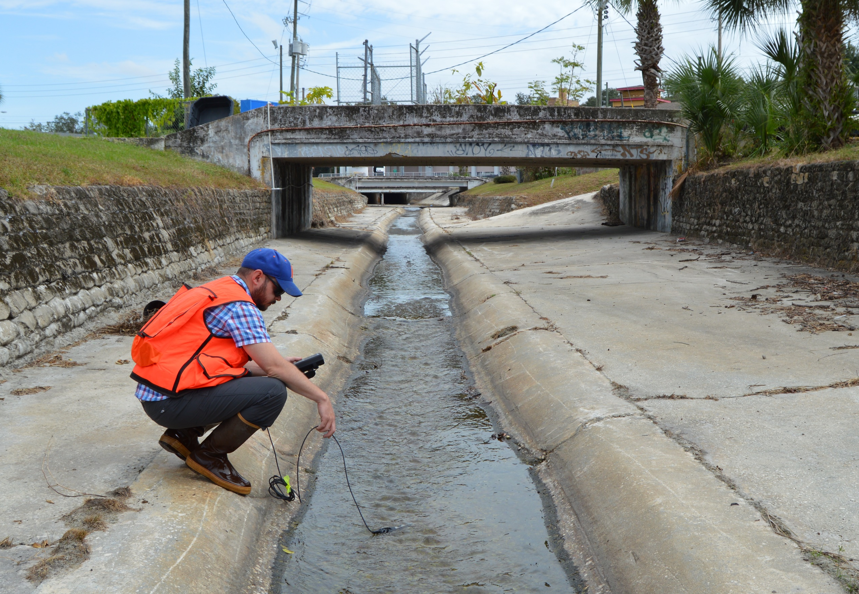
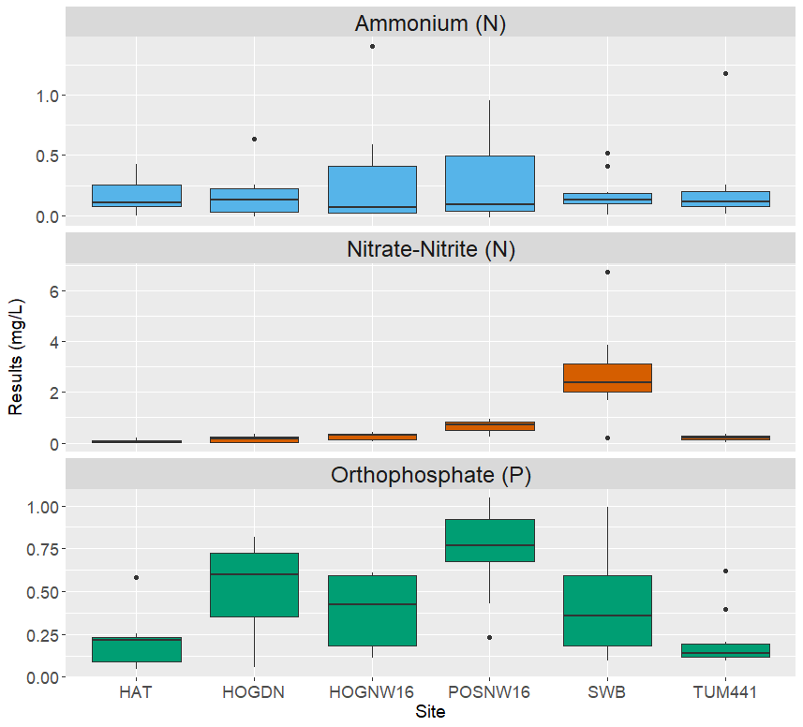
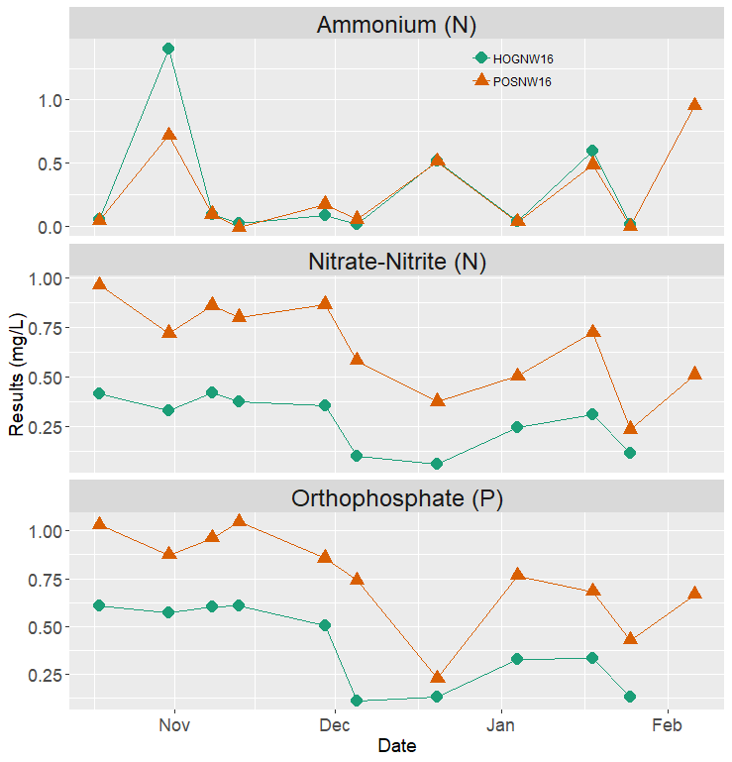
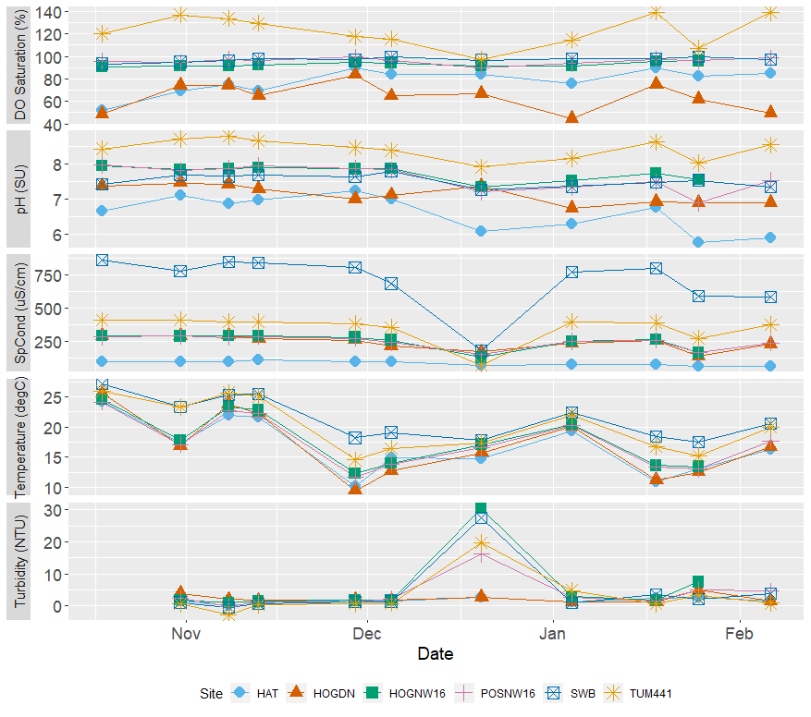
Landscape Patterns Drive Variability In Water Chemistry Across Sub-tropical Urban Streams
Emily Taylor and Alexander J. Reisinger
Soil and Water Sciences Department, University of Florida
NATURAL
RESIDENTIAL
DEVELOPED
NATURAL
RESIDENTIAL
DEVELOPED

